Slide 1
A Compressed Discussion about Google Extensions
Tremaine McKinley

Slide 2
Agenda
What is an Extension?
Why should I try it?
Building a simple extension
Code walkthrough
Takeaways & resources

Slide 3



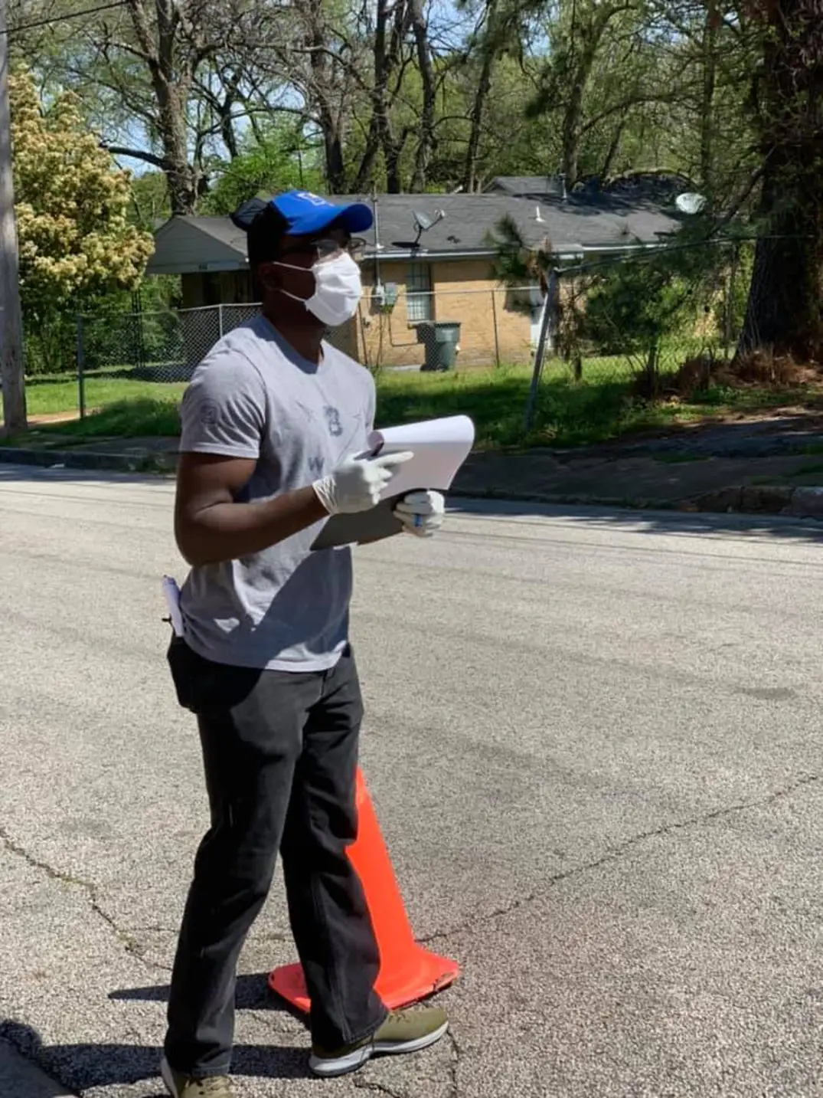
Personal Story Time Education: Chromebook Administration

Slide 4


A Google Extension!

Slide 5

What is an Extension?
Light-weight web apps that can use Chrome-supplied APIs to enhance your browsing.

Slide 6
Google’s Overview
Chrome extensions enhance the browsing experience by:
Customizing the user interface
Observing/modifying the web
Extending web services

Slide 7
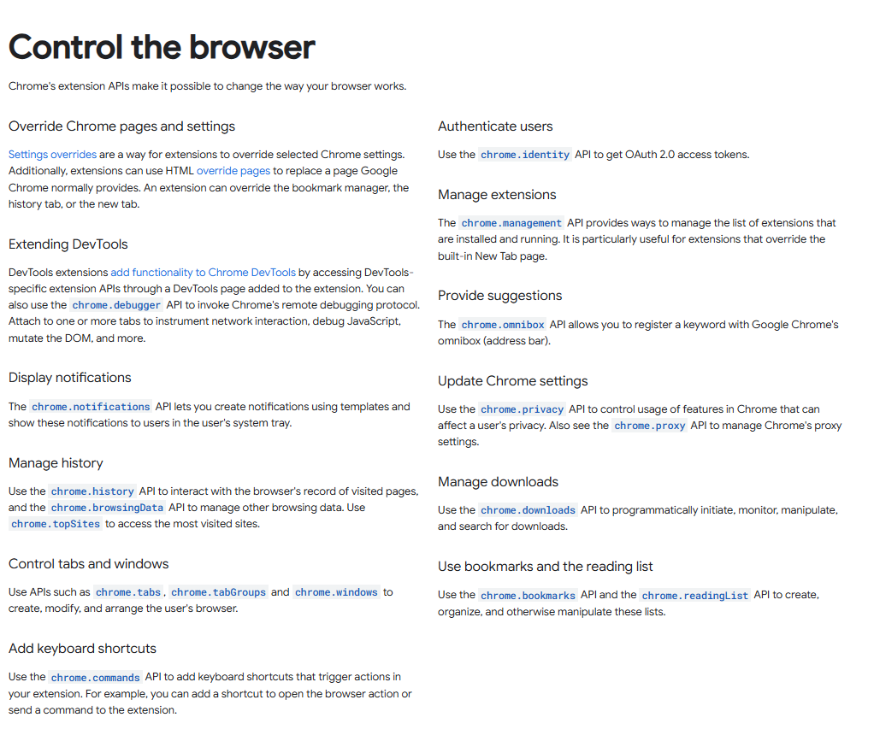
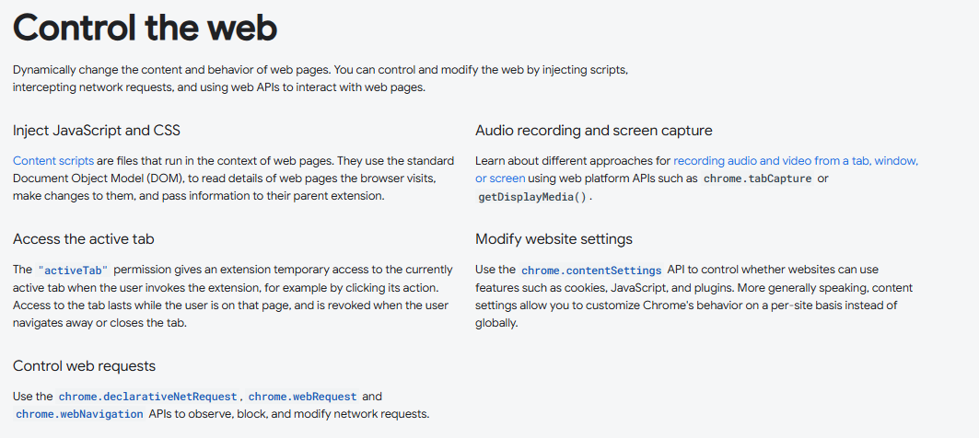

Slide 8

Building a simple Extension

Slide 9

Why Build a Chrome Extension?
Practical reasons to build Chrome Extensions
New Devs/ Business Cases | Simple, safe distribution (Web Store) Low barrier to entry (Web dev, APIs)
Personal Projects | Solve niche problems specific to your workflow Easy deployment for prototyping
Professional Opportunities | Diversify your (dev) portfolio Extend existing services into browsers

Slide 10
Extension make-up
Extension Packet
Background.js (Service Worker)
Interface (Popup/Sidebar)
Icons
.PNG files
popup.html (popup.css)
popup.js
Favicon
48x48
128x128
manifest.json
Manifest File
Contains the metadata and mapping instructions for your extension. (required)
Popup/sidebar
The frontend of your extension
Background
Service worker file runs in the background. For functions that happen without the popup running.

Slide 11

Code Walkthrough Meet Nudge, the study buddy

Slide 12
Code Walkthrough Key Scripts
manifest.json
Defines the extension's metadata and permissions, including chrome.storage and chrome.notifications.
background.js
Listens for extension icon clicks and initializes sidebar functionality.
Sets up periodic alarms and listens for tab creation events.
content.js
Handles UI interactions within the sidebar.
Retrieves and saves study materials from Chrome storage.
</>

Slide 13


Thank you!
Tremaine McKinley
Connect with me on LinkedIn or Discord!
Extension documentation

